Slide 1
PHYS 304: Lecture 3
(Intro to) Quantum Mechanics
Sept-Dec 2021 Edition
Jeff Young
brimacombe Rm 278, young@phas.ubc.ca

Slide 2
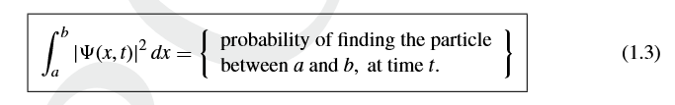
Review of Key points from last day
Classically, we can calculate the position of a particle at all times, x(t) (and hence know precisely all the information possible about its dynamics), using Newton’s equation of motion, knowing the particle’s position and velocity at specified times , and the force field acting on the particle.
Quantum mechanically, the most complete calculation of a particle’s dynamics involves solving Schrödinger's equation for the particle’s (complex) wavefunction, ψ(x,t), given the force field and the wavefunction at some time t₀.
In classical mechanics, x(t) is a dynamical variable where x represents the position of the centre of mass of the particle. In quantum mechanics, x is not a function of t, and is merely a parameter representing a cartesian coordinate in space.

Slide 3
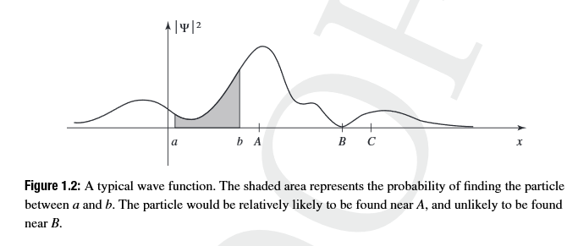
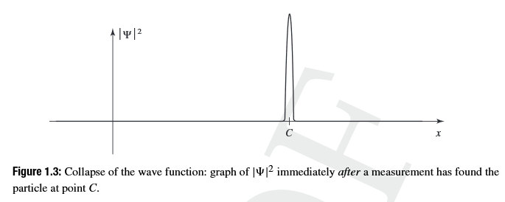
Review of Key points from last day
Notes:
The act of measurement changes the wavefunction (in general).
Makes sense, since doing a measurement involves applying some “additional” potentials not included in how one would have used to solve for the wavefunction before the measurement.

Slide 4
Today’s Activities
Develop some intuition for the relationship between wave-like and particle-like behaviours
Introduce a measure of the degree of “localization” of a wave function
An intuitive derivation of “the momentum” associated with a wavefunction
Bi-weekly quiz (4:40-4:50 on Canvas)

Slide 5
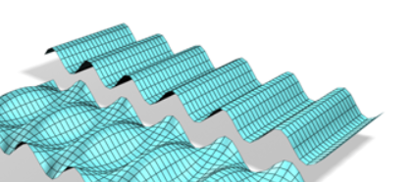
Particle/Wave Concepts
Lecture 3, Activity #1 (TPS Poll)
Ex#1: Particle or Wave?
Ex#2: Particle or Wave?
https://youtu.be/jcXF1jvhMx4
Ex#3: Particle or Wave?
https://www.youtube.com/watch?v=MBSZcCT0wvA
Notes:
Of course they are all “waves and particles” in quantum mechanics! But intuitively, first one straight forward, Second also straight forward, just tell them to visualize it moving….time averaged, same everywhere in space. Third: random superposition of waves.
Ask if anyone can relate 1 and 3? Classical particle represented by a coherent superposition of many waves with different wavelengths…a wavepacket.
Spend some time digging deeper on these:
Sketch mag and phase of Psi(x,y,t) for each case. Note subtlties: case 1 and 3 mag Psi^2(x,y,t), with video giving time dimension. Case 2 ambiguous (no axes, static picture). Could be Psi^2(x,y) at a fixed t, or Re(Psi)(x,y) at fixed t, or Re(Psi)(x,t) for a fixed y. Lets assume it is Psi^2(x,y) at a fixed t for now. What is the key parameter that makes one choose “particle-like” versus “wave like”? Again, subtle: when see video (t dep), then it is the fact that the particle remains localized as it moves in case 1, whereas it is always delocalized in case 3.
Case 2 and case 3 most similar…how do you think they are related?

Slide 6
Lets see what happens when you add waves
Run Fourier PHET
Notes:
Key Points:
plane wave is “perfect” wave, i.e. infinitely and uniformly delocalized (Psi^2), and characterized by a wavelength \lambda
Adding plane different waves with different wavelengths introduces some degree of non-uniformity in Psi^2 (SUM OF WAVES) SQUARED, NOT SUM OF (WAVES SQUARED)
Depending critically on the relative phase and range of different wavelength waves, the sum can in some cases be made to resemble a localized particle
Could(?) use this to introduce the uncertainty principle here (where just quote result, in terms of delta x and delta lambda, not delta p, and emphasize the equality only occurs in the limit (typically associated with a particle-like wavefunction. Example 1 likely nearly at the equality point, example 3 far off.

Slide 7
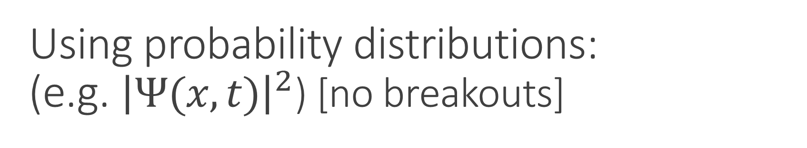
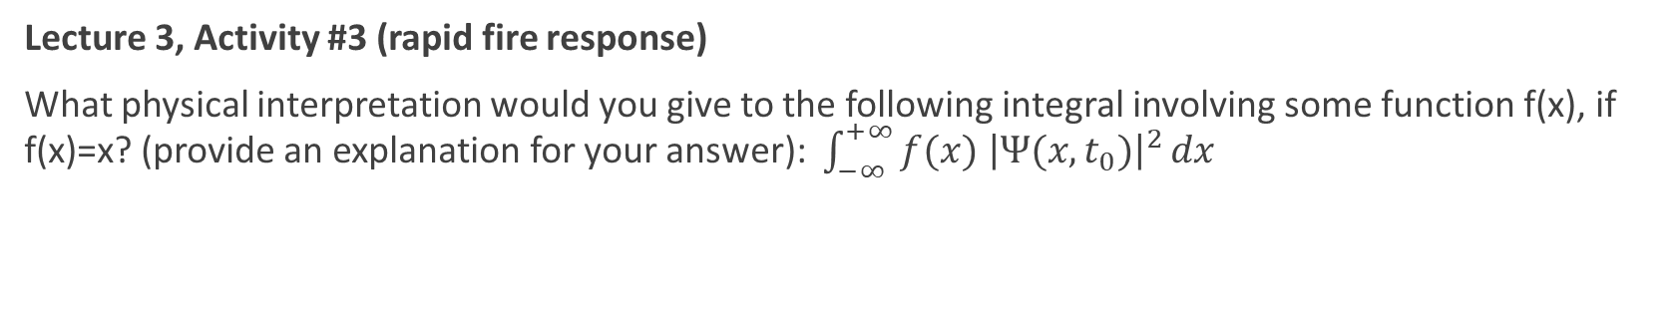
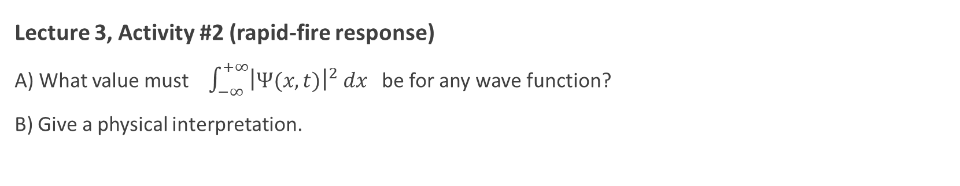
Using probability distributions:
(e.g. ${\left|Ψ(x,t)\right|}^{2}$) [no breakouts]
Lecture 3, Activity #2 (rapid-fire response)
A) What value must $\int_{−∞}^{+∞}{{\left|Ψ(x,t)\right|}^{2}}dx$ be for any wave function?
B) Give a physical interpretation.
Unity, since the particle must be somewhere, so adding up all the probabilities of finding it where it might possibly be must equal unity.
Lecture 3, Activity #3 (rapid fire response)
What physical interpretation would you give to the following integral involving some function f(x), if f(x)=x? (provide an explanation for your answer): $\int_{−∞}^{+∞}{f(x) {\left|Ψ(x,t_{0})\right|}^{2}}dx$
This is the average value you might measure if you had multiple copies of the same wavefunction and measured it several times, getting, in general, a different value of the particle’s location each time you measured it. Or, if you had an ensemble of identical wavefunctions and measured them all, and plotted the various locations x that you measured from each member of the ensemble, this would be the average value measured.

Slide 8
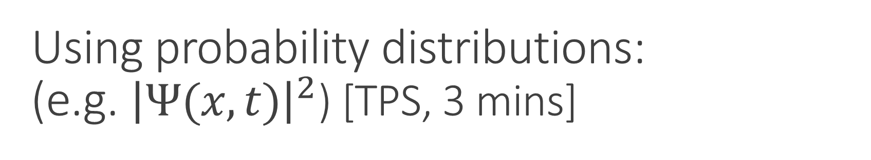
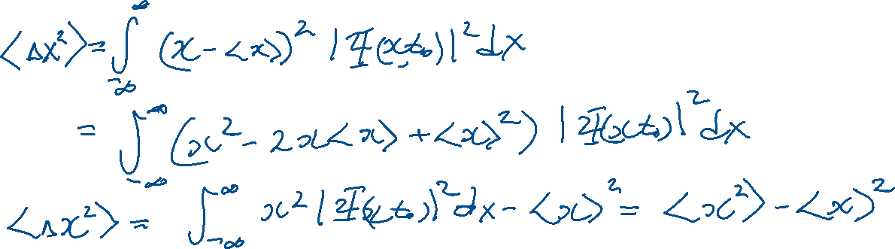
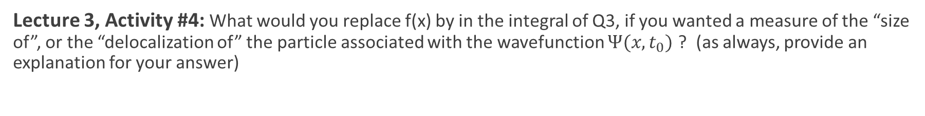
Using probability distributions:
(e.g. ${\left|Ψ(x,t)\right|}^{2}$) [TPS, 3 mins]
Lecture 3, Activity #4: What would you replace f(x) by in the integral of Q3, if you wanted a measure of the “size of”, or the “delocalization of” the particle associated with the wavefunction $Ψ(x,t_{0})$ ? (as always, provide an explanation for your answer)
(x-the average value of x)² or Δx²
Notes:
Q4: Why not x- average x? Because zero, and adding absolute value signs not mathematically convenient, better to square it. Draw an distribution on the board and note at a given x, the “distance” from the mean is x - <x>
Q5: Draw 1D time slices of localized wavepacket probability distribution as it moves for different times, indicating that <x> varies with time, so should differentiate to get estimate of momentum. See handwritten notes for details. Does this give the distribution of the momenta values you might get when you measure the particle’s momentum? Ans: No

Slide 9
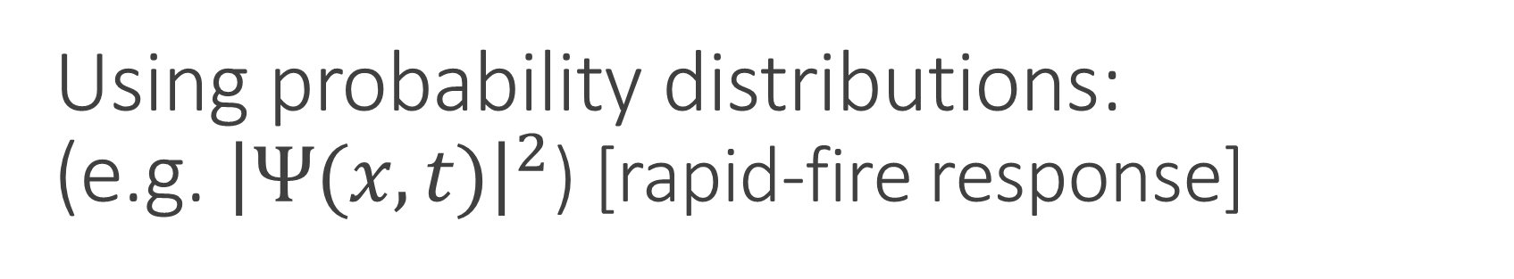
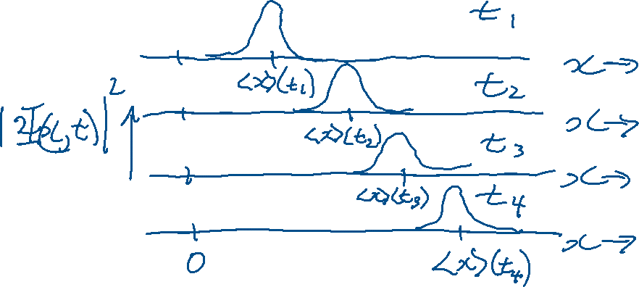
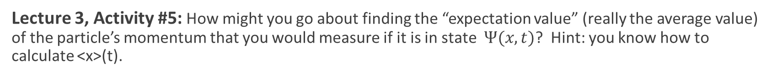
Using probability distributions:
(e.g. ${\left|Ψ(x,t)\right|}^{2}$) [rapid-fire response]
Lecture 3, Activity #5: How might you go about finding the “expectation value” (really the average value) of the particle’s momentum that you would measure if it is in state $Ψ(x,t)$? Hint: you know how to calculate <x>(t).
d<x>(t)/dt…make sense?

Slide 10
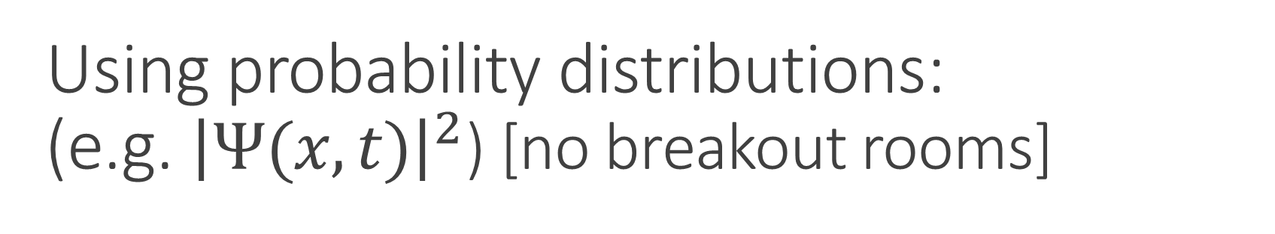
Using probability distributions:
(e.g. ${\left|Ψ(x,t)\right|}^{2}$) [no breakout rooms]
Lecture 3, Activity #5 con’t: Goto .pdf notes

Slide 11
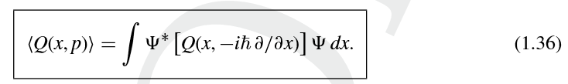

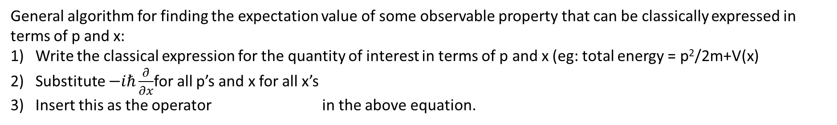
Using probability distributions:
(e.g. ${\left|Ψ(x,t)\right|}^{2}$) [no breakouts]
Lecture 3, Activity #6:
Write an expression for how to calculate the expectation value of a particle’s total energy (kinetic plus potential) using:
General algorithm for finding the expectation value of some observable property that can be classically expressed in terms of p and x:
Write the classical expression for the quantity of interest in terms of p and x (eg: total energy = p²/2m+V(x)
Substitute $−iℏ\frac{∂}{∂x}$for all p’s and x for all x’s
Insert this as the operator in the above equation.
Notes:
General algorithm for finding the expectation value of some observable property that can be classically expressed in terms of p, and x is:
Write classical expression for the quantity of interest in terms of p and x (e.g. total energy =p^2/2m+V(x).
Substitute –ihbar d/dx for all p’s and x for all x’s
Insert between psi^*(x) and psi(x) in Eqn. 1.36 and evaluate.

Slide 12
Biweekly Quiz #1
Goto Canvas

